Slide 1
SCA 40% EFFICACY POST-PROCEDURE
POSTER
Sociedad Española Medicina Estética

Slide 2
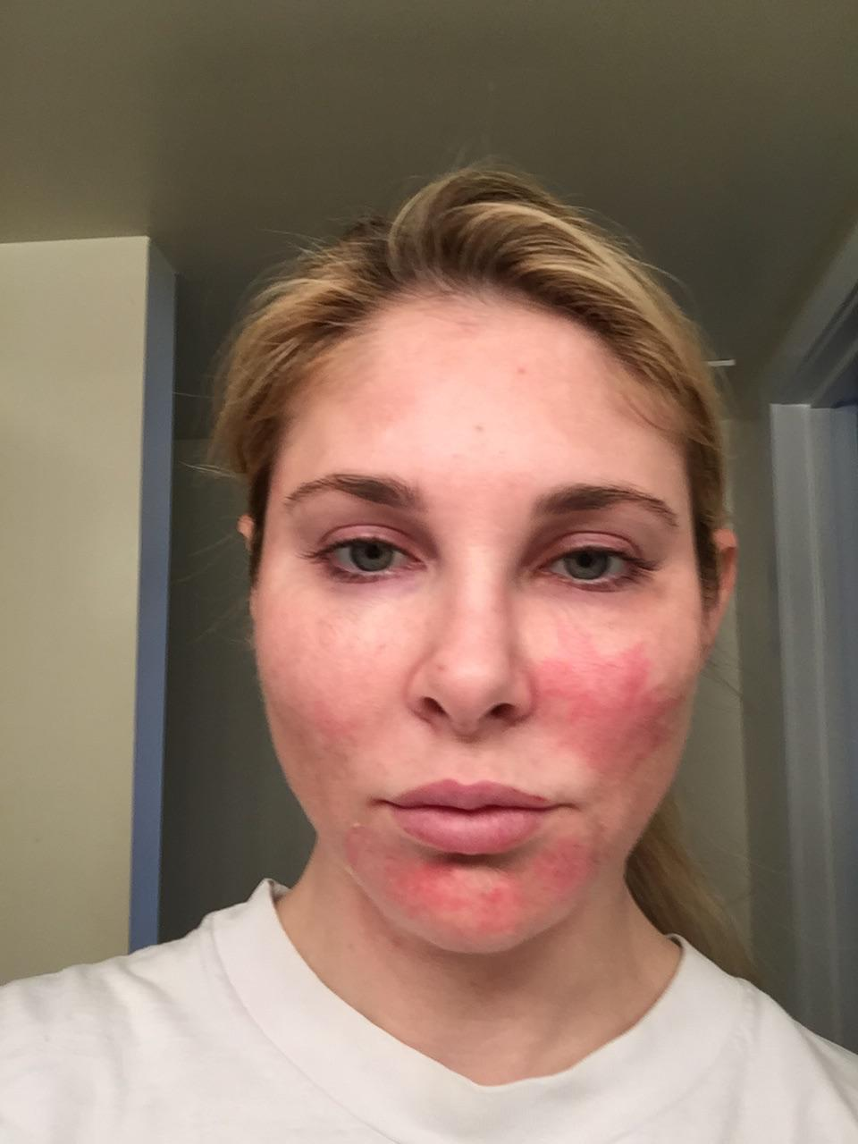
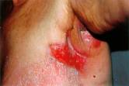
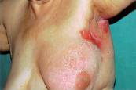
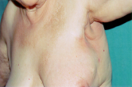
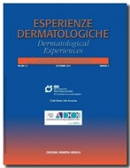
BACKGROUND
High-concentration SCA formulations have been indicated for post-procedure skin healing and rejuvenation
Ledo E, 1999
Chemical Peeling - Sisto T, Dermatological Experiences 2013
Fractional laser & oxygen therapy - Mavilia L et al, hi.techdermo 2011
Fractional Ablative Laser - Celleno L, Sacro Cuore University, Rome, 2013
data on file, 2016
Truchuelo MT (J Cosmet Dermatol, 2019) demonstrated that 40% SCA after non-ablative fractional laser accelerated healing, reduced adverse effects, and enhanced procedure outcome.

Slide 3
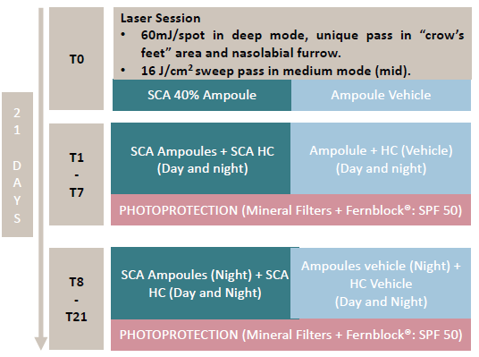
Objectives:
demonstrate the efficacy of SCA 40% in accelerating healing and reducing side effects after CO₂ ablative fractional laser
demonstrate efficacy of SCA 40% in improving procedure outcome
Materials & Methods:
double-blind, split-face, 10 women with moderate to severe skin aging
ablative CO₂RE® Fractional laser (Candela) followed by application of SCA 40% ampoule + SCA 6% hydrating cream or vehicles according to following régimen:

Slide 4
Evaluations:
Healing: microcolumn density (dermatoscopy) & TEWL (Tewameter)
Adverse effects: edema, erythema, burning sensation, tightness
Anti-aging (procedure enhancement): elasticity & firmness (Cutometer), skin texture and wrinkles (Visioface & Visioscan)
IGA & PGA

Slide 5
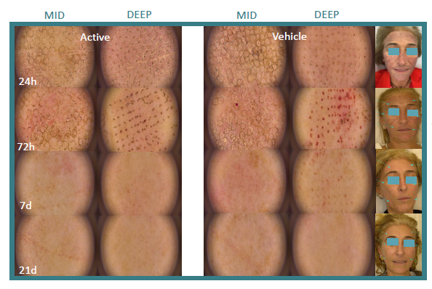
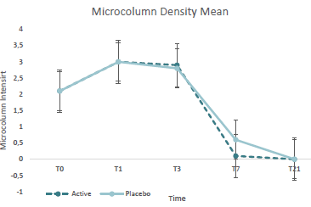
RESULTS
SCA accelerates healing, reducing microcolumn density and TEWL faster than vehicle
Microcolumn density
*
After 7 days, SCA-treated hemiface microcolumn density is 83% lower than vehicle-treated hemiface (p=0.04)

Slide 6
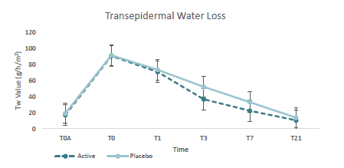
RESULTS
SCA accelerates healing, reducing microcolumn density and TEWL faster than vehicle
TEWL
TEWL is significantly lower on the SCA-treated side vs vehicle at T3 and T7 (p < 0.05)
*
*

Slide 7
RESULTS
SCA reduces adverse effects vs vehicle
SCA Regimen side showed a significantly greater decrease in erythema (T3, T7, T21), burning sensation (T3, T7) and tightness (T3, T7) when compared to vehicle (p < 0.05)
SCA reduces wrinkles, enhancing anti-aging procedure results
SCA Regimen side showed an average of 50% greater improvement in wrinkles vs vehicle (T21, p < 0.05) as measured by skin roughness parameters (Visioscan)
SCA regimen showed very good tolerance

Slide 8
CONCLUSIONS
Application of SCA 40% immediately after non-ablative fractional laser, and on the following days together with a SCA 6% hydrating cream, can accelerate healing, reduce adverse effects, and enhance procedure outcome, making it a valuble tool for all skin care specialists. Tolerance was very good.
SCA 40% should be used following all CO₂ ablative fractional laser procedures to ensure maximum patient compliance and satisfaction

